Slide 1
Git & Github 101
Version control and you.

Slide 2
Why use version control?

Slide 3
Backup and Restore
Files are saved as their edited.
Jump back to a specific change in time.
Browse by commit, branch, or code change.

Slide 4
Synchronization
Share files and stay up-to-date.
Keep up with multiple developers at the same time.

Slide 5
Undo
Throw away a small change by just reverting to the last “good” version.
If you made a mistake a long time ago, jump back and fix it.

Slide 6
History
Track the history of a set of files.
See the entire commit history from everyone.

Slide 7
Sandboxing
If you want to make a radical change to your code base, just create another branch.
When you’re reading, just merge it into the master branch.

Slide 8
What is Git?

Slide 9
Git?
Git is a distributed version control system.
It allows for easy collaboration and version control.
It was created in 2005 by Linus Torvald for development on Linux. Today, it is one of the most popular versioning systems out there.

Slide 10
How does Git work?
Repositories!
It holds the history of all changes.
In a general sense, the repo is a directory.
You use Git through a CLI (Windows Command Prompt, Terminal, et cetera)

Slide 11
How would I use Git?
Collaborate with others.
Get the correct solution for a problem.
Have your work corrected.
Make your work available to the world!

Slide 12
How do I use Git?

Slide 13
The Clone Wars
To get the code and history of any repository, you clone it.
git clone git://github.com/eturk/jack

Slide 14
History of the World, Part I
To see the history of any repository, you see the log of it.
git log

Slide 15
Commit!
Every change in the history of a project is represented by a commit. Each commit has a SHA-1 ID.

Slide 16
Branches
A branch is a different version of the same project.
You use a branch for keeping some code separate from the main branch (usually called “master”).
For example, I use the branch “stable” to differentiate between my development (“master”) and my code that is ready for use (“stable”).

Slide 17
Branches
You can see the current branch you’re using.
git branch
And change the current branch.
git checkout foobar

Slide 18
Merging
Once you’ve isolated a branch, you’ll want to incorporate those changes back into the main branch. You want to select the branch you want to merge into and specify the branch you’re merging from.
git checkout stable
git merge master

Slide 19
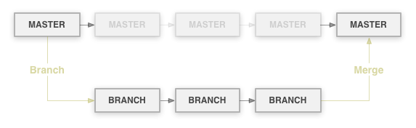
Branches & Merging

Slide 20
Branches & Merging
When you merge, Git will show you a diff.
A diff is the difference between the current code and the code you want to merge in.
git diff

Slide 21
The Downfall of the Magical Merge
When the same block of code is edited in two branches, Git doesn’t know how to merge.
Instead, it’ll give us a “merge conflict” error and insert markers in the file where the difference is.

Slide 22
The Downfall of the Magical Merge
<<<<<<< HEAD
Many Hello World Examples
=======
Hello World Lang Examples
>>>>>>> fix_readme
This project has examples of hello world in nearly every programming language.

Slide 23
The Downfall of the Magical Merge
What do I do?!
Resolve it manually by changing the file to the correct code. Remove the markers and re-add it with git add.
Undo the changes on the current branch by using…

Slide 24
Stash to the rescue!
If you have a merge conflict, using stash will throw away the changes to the current branch and allow you to merge.
git stash

Slide 25



All Your Rebase Are Belong to Us
Instead of merging with last commit, you use the latest commit.

Slide 26
Push & Pull
To move your changes to a remote repository (a.k.a. GitHub), you push the changes.
git push [remote] [branch]
To get the latest changes to a remote repository, you pull or fetch the changes.
git pull [remote] [branch]

Slide 27
Example Workflow
(make some changes)
git add .
git rm some/unneeded/file
git commit –m ‘Made some changes, removed an unneeded file.’
git push origin master

Slide 28
Example Workflow
git checkout master
(make some changes)
git checkout stable
git merge master
git push origin stable

Slide 29
Best Practices
Commit Often
When writing a school paper, you save your document often. The same applies to Git.
Pull Often
Having the latest version of the code will cut down on the amount of times you have merge conflicts.

Slide 30
Collaboration with Git
You're working on a project called HelloWorld with Joe & Bob.
Everyone has their own repository on their computer and hosted on the Internet.
Your online repository is the official repository. Joe and Bob's are for development (so when someone wants to use HelloWorld, they would get the code from your repository).

Slide 31
Collaboration with Git
Joe's making a new feature. He would work on it and push to his online (or "remote") repository.
When you're satisfied that it works, you'd incorporate it into the main repository by "pulling in" his code into a new branch on the remote repository.
You'd then merge the new branch into the main branch.
Then, Bob would run git pull on his computer's (or "local") repository to get the latest code.
Remember, commit and pull often!

Slide 32
Where do I host online?
For the longest time, http://repo.or.cz has been the standard. Until…

Slide 33


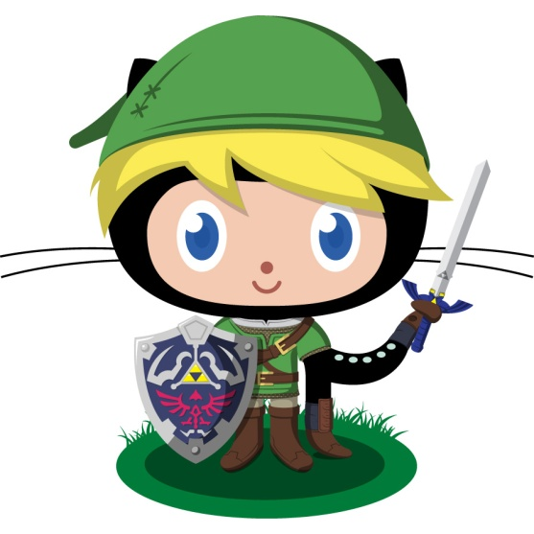


GitHub
Founded in 2008 by Chris Wanstrath, PJ Hyett, and Tom Preston-Warner, it has grown to 1 million users and over 2 million active repositories.

Slide 34
The Slide of Features™
Browse code online with syntax highlighting.
View file history.
Blame and annotations (view who made changes when and where).
Online editor.
Git-powered Wikis.
Integrated issue tracking, with milestones, labels, search.
Code Review
Pull Request = Code + Issue + Comments
Comments (comment on commits, files, or even specific lines).
Network graph (shows all forks).
Compare view (see differences in commits)
Community
Watch repositories and users.
Profiles
Explore!

Slide 35

Who Uses GitHub?
Linus Torvald and the Linux kernel
Twitter
Facebook
Rackspace
Yahoo!
Shopify
EMI
Six Apart
Sun/Oracle
Node.js
Apache

Slide 36
Fork this!
On GitHub, you can fork repositories.
This will give you your own repository of the code. Clone it, make some changes, and push to your repository.
Then, on the main repository (the owner’s), make a Pull Request.

Slide 37
Pull Requests
Pull Requests alert the project’s owner of your changes.
You are requesting them to merge your changes into the project.
These can be attached to Issues.
Pull Requests = Code Review

Slide 38
Issues
Issues are attached to a project.
If you see something is not working with a project, create an issue. If you want a feature, create an issue.
Keep track of what you need to do.
Add Labels and Milestones.
Issues = Discussion

Slide 39
Gists
A Gist is an easy way to share code snippets and pastes with others.
They are Git repositories, so they are versioned, forkable, and you can use them like any other Git repository.

Slide 40




Futher Reading
Git Tutorial http://coo.ly/smi
Git Reference http://coo.ly/KDJ
Version Control for Designers http://coo.ly/vvJ
Roger Dudler’s Git Guide http://coo.ly/DwW
Octocats provided by The Octodex.

